Slide 1

Containerized Item Exchange Application
Full DevOps Deployment

Slide 2
Problem Statement
Manual Deployment Risks: Traditional deployment of the Item Exchange App was manual, leading to human error and potential downtime.
Environment Inconsistency: "It works on my machine" issues between development and production
Lack of Automation: No standardized process for testing and pushing code, resulting in slow-release cycles.

Slide 3
Proposed Solution
Fully Automated DEVOPS Pipeline: A "commit-to-production" workflow ensuring seamless updates, high availability, consistency and automated infrastructure management.

Slide 4
Cloud-Native Infrastructure
Key Features
Automated CI/CD
Full-Stack Containerization
Distributed Build Architecture
Lightweight Orchestration
Secure Data

Slide 5
Tools & Infrastructure
AWS EC2
AWS RDS
AWS ECR
Terraform
Docker
K3S
Traefik
Jenkins

Slide 6
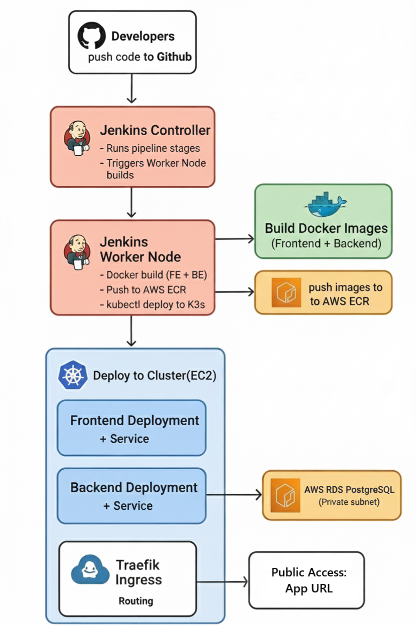
Architecture Design

Slide 7
Implementation Phase 1 – Containerization & Registry
Container Strategy:
Frontend container: Multi-stage build (React build → Nginx serve).
Backend container : Node.js environment running Express & Socket.io.
AWS ECR (Elastic Container Registry):
Two repositories: jack-frontend and jack-backend.
Automation: Jenkins automatically pushes new tagged images to ECR on every successful build.

Slide 8
Implementation Phase 2 – AWS Infrastructure Setup
EC2 Ubuntu 22.04:
K3s Cluster Node: Runs K3s Kubernetes and hosts the entire application.
Jenkins Controller: Orchestrates CI/CD pipeline execution.
Jenkins Worker Node: Runs Docker builds and kubectl deployments.
AWS RDS (Relational database service):
Engine: PostgreSQL.
Security: Placed in a Private Subnet.
Access Control: Security Group configured to accept traffic only from the Backend K3s pods.

Slide 9
Implementation Phase 3 – K3s Deployment & Ingress
Orchestration (K3s):
Deployed lightweight Kubernetes on EC2.
Managed via Deployments (ReplicaSets) and ClusterIP Services.
Configuration:
Environment variables (like DATABASE_URL) injected via ConfigMaps and Secrets.
Traffic Management:
Traefik Ingress Controller: Routes incoming HTTP traffic.
Public Access: Application live at http://16.170.173.4.

Slide 10
Implementation Phase 4 – Jenkins Pipeline Workflow
Pipeline stages :
Checkout GitHub repo
Log in to ECR Public
Build frontend image
Build backend image
Push both images
Deploy to K3s using
Architecture:
Jenkins Controller → Manages jobs
Jenkins Worker → Builds Docker, pushes images, deploys to K3s.

Slide 11
Live Application(on production)
App Url

Slide 12
Project Team + Roles
Team member | Role
Sama Mostafa Fazaa | - Design & implement CI/CD (Jenkins). - Automate build and deploy pipeline to AWS.
Ahmed Hamdy Mahmoud Elshewemy | - Write Terraform templates. - Keep infrastructure versioned and reusable.
Osama Mamdouh Mohamed | - Create Docker files for the item-exchange app - Build and push images to Amazon ECR
Omar Said Omar | - Create AWS account and monitor AWS costs. - Configure VPCs and security groups
Mahmoud Gomaa Abouelfetouh | - Deploy and manage the K3s cluster on EC2. - Configure Traefik Ingress, Services, and Deployments.
Mayar Khaled Mostafa | - Configure the AWS RDS PostgreSQL instance. - Manage database connectivity and private subnet configuration.

Slide 13
Thank You

